Slide 1

SANJIVANI COLLEGE OF ENGINEERING
Kopargaon, Maharashtra
Ambulance Routing and Traffic Signal Priority Using the Chinese Remainder Theorem (CRT)
Sr. | Name of Student | PRN
1 | Sakshi Sonawane | 0126UCSF2012
2 | Pratiksha Mali | 0126UCSF2013
3 | Sakshi Surse | 0126UCSF2014
4 | Sujit Rathod | 0126UCSM2015
Under the guidance of
Prof. S.N.Gunjal

Slide 2
Introduction
Ambulances lose valuable minutes at red signals and in congested city traffic.
In an emergency, every minute of delay can reduce a patient’s chance of survival.
Each traffic signal runs on its own cycle time and start offset, so signals are rarely green together.
Our project models every signal as a modular congruence and uses the Chinese Remainder Theorem (CRT) to find the earliest time when all signals on the route are green one after another.
This creates a green corridor so the ambulance reaches the hospital faster and more safely.
The Problem
Independent signals force the ambulance to stop again and again.
Our Idea
Use number theory (CRT) to synchronise signals along the route.

Slide 3
Problem Statement and Objectives
Objectives
Problem Statement
Traffic signals along an ambulance route work independently, each with a different cycle time and start offset. This causes repeated stops and delays. We need a mathematical method to find the earliest moment when all signals on the route are green for the ambulance.
Reduce ambulance travel time to the hospital.
Model each traffic signal as a modular congruence.
Apply CRT to compute the earliest common green time.
Create a green corridor for emergency vehicles.
Improve safety for patients, drivers and other road users.

Slide 4
Chinese Remainder Theorem (CRT)
CRT solves a system of simultaneous congruences.
If the moduli m₁, m₂, …, mₖ are pairwise coprime, the system has exactly one solution modulo N = m₁ × m₂ × … × mₖ.
It was described by Chinese mathematicians over 1,500 years ago and is used today in cryptography, scheduling and computing.
Here it tells us when different repeating cycles line up at the same moment.
The Formula
System:
x ≡ a₁ (mod m₁)
x ≡ a₂ (mod m₂)
x ≡ a₃ (mod m₃)
Solution:
x = Σ aᵢ · Nᵢ · yᵢ (mod N)
Nᵢ = N / mᵢ
yᵢ = inverse of Nᵢ (mod mᵢ)

Slide 5
Modelling Traffic Signals with CRT
Traffic Concept | Mathematical Meaning
Cycle time of a signal | Modulus mᵢ
Time at which the signal turns green (adjusted for travel time) | Remainder aᵢ
Time when the ambulance starts its trip | Unknown x
Earliest time all signals are green in sequence | Smallest positive x in the solution
Repeat of the whole pattern | Every N = m₁ × m₂ × … units
Each signal i gives one congruence: x ≡ aᵢ (mod mᵢ). Travel time to that signal is subtracted so the light is green exactly when the ambulance arrives.

Slide 6
Working Methodology
1
2
3
4
5
Collect Data
Form Congruences
Check Coprime
Apply CRT
Green Corridor
Route, signal cycle times, offsets and travel times between signals.
Write one congruence x ≡ aᵢ (mod mᵢ) for every signal.
Ensure the cycle times are pairwise coprime for a unique solution.
Compute N, Nᵢ, inverses yᵢ and the sum to get x.
Start the ambulance at time x so every signal is green on arrival.

Slide 7
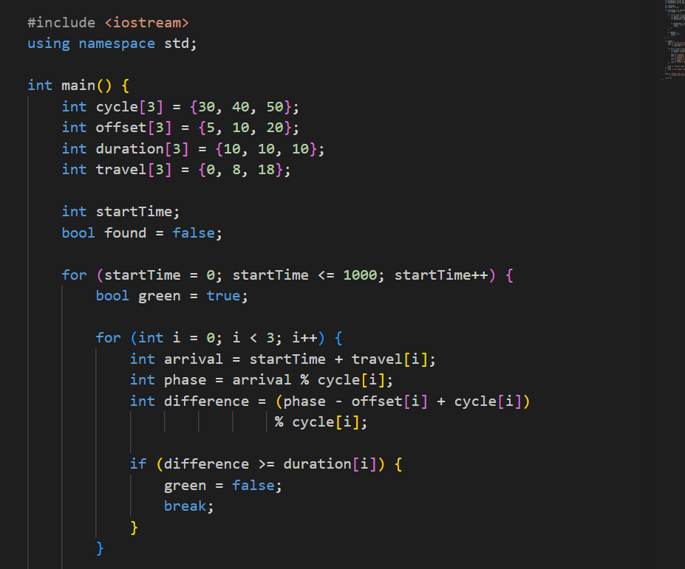
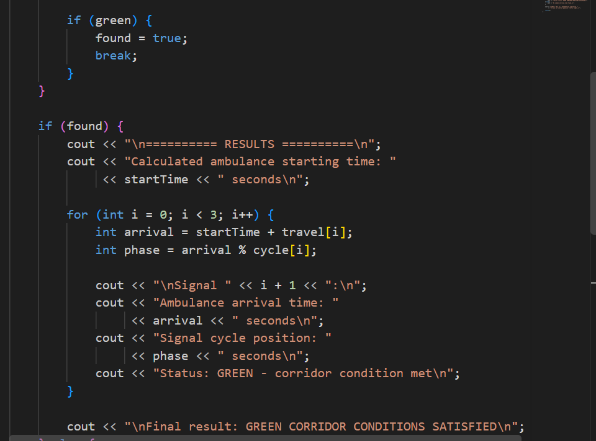
Implementation

Slide 8
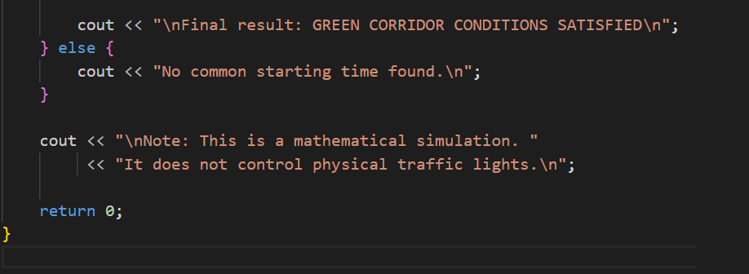
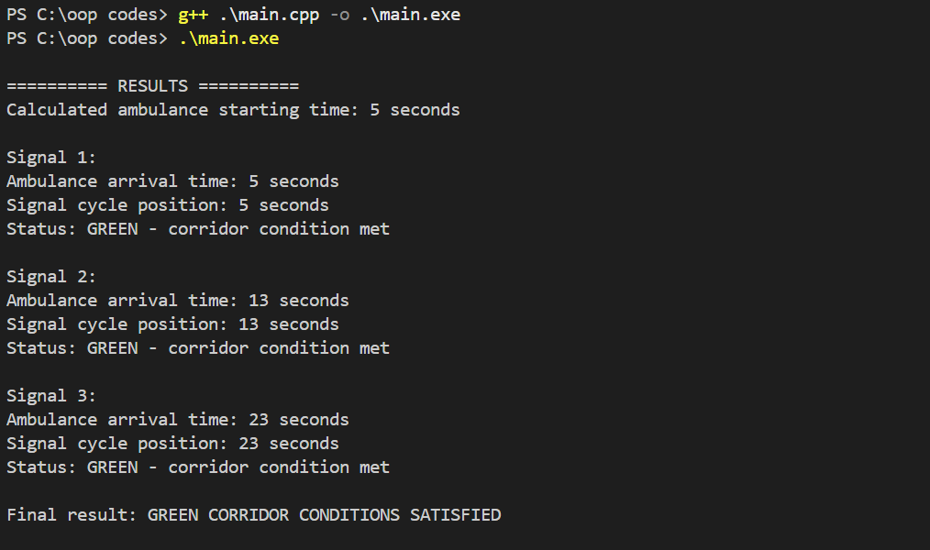
Implementation

Slide 9
Advantages and Applications
Advantages
Applications
Faster ambulance response and hospital arrival.
Exact, mathematically guaranteed solution.
Simple calculation, no heavy hardware needed.
Fewer stops, so lower accident risk at junctions.
Works for any number of signals on a route.
Smart city traffic management systems.
Emergency routes for fire brigades and police.
Hospital and ambulance control rooms.
VIP and disaster-relief convoy movement.
Traffic signal scheduling and simulation.

Slide 10
Limitations, Future Scope and Conclusion
Limitations
Future Scope
Cycle times must be pairwise coprime.
Real traffic and road conditions vary.
Needs accurate signal timing data.
Live GPS tracking of the ambulance.
IoT-controlled smart signals.
Generalised CRT for non-coprime cycles.
Conclusion CRT gives a simple and exact way to synchronise traffic signals, creating a green corridor that saves time when every second matters.

Slide 11
Thank You

